Slide 1



Applications of Machine Learning for IODP Petrophysical Well Log Data
Peter Flaming
Research Graduate Student
Southern Methodist University

Slide 2

Outline of Topics Covered
Introduction
Overview of Data Science
DataScience@SMU
Overview of Machine Learning (ML)
Types of Machine Learning
Common Algorithms
Selected ML Applications in Geoscience:
Geology and Geophysics Cases:
Facies Classification
Petrophysical Data Prediction
Conclusion
Data Science Issues
Considerations
Questions
References
Hands-On Supervised Machine Learning with IODP Data!!!

Slide 3
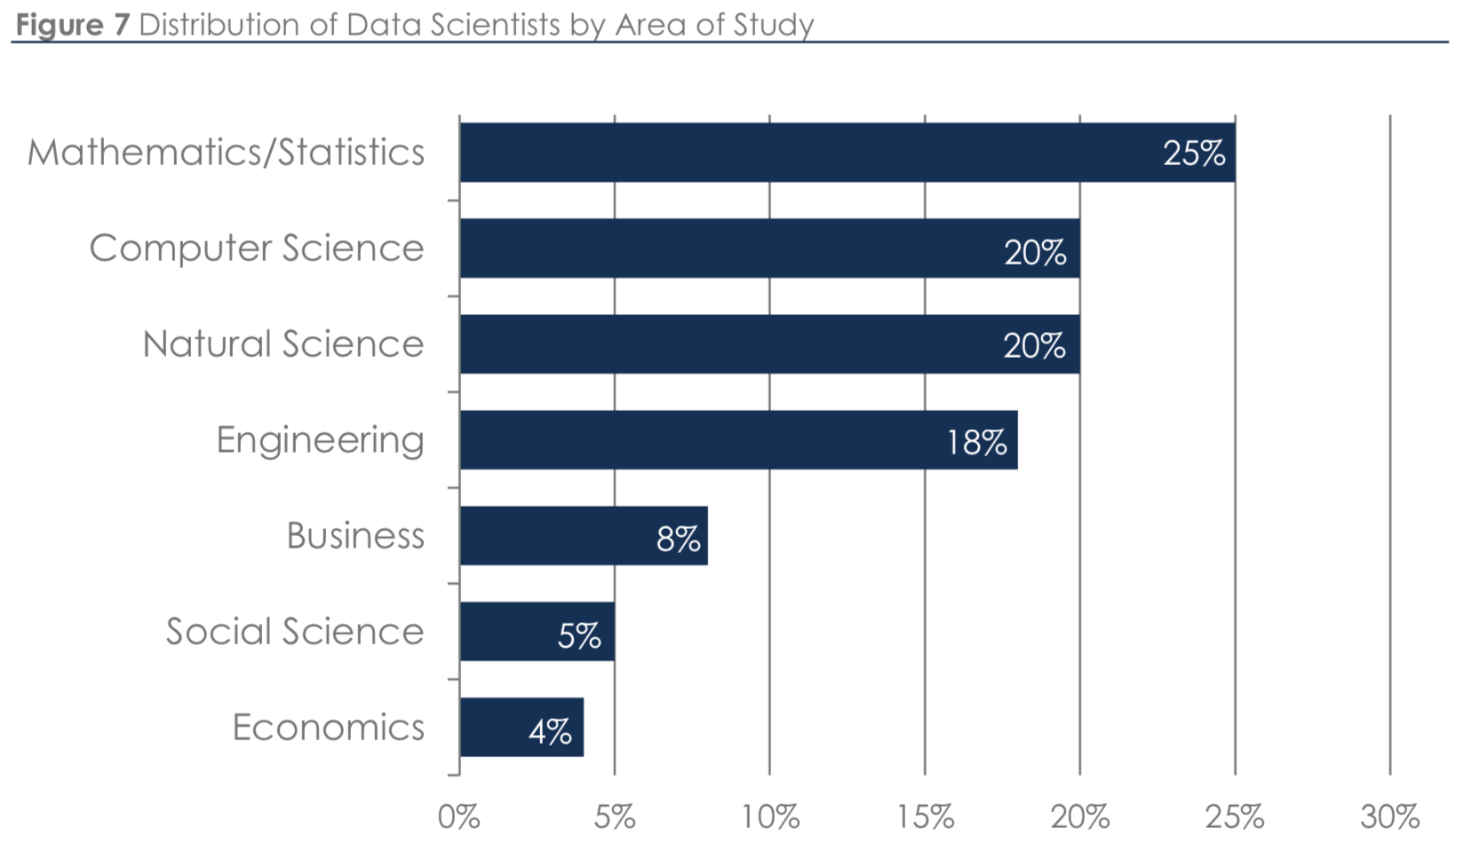
Introduction – Overview of Data Science
The field of data science is one of the fastest-growing and most in-demand fields in the world.
Data Science enables us to gain highly sought-after information from data
By working with unstructured data, big data processing, statistical analysis, text mining and machine learning Data Science can tell the story of data and improve how business decisions are made.
The increased need across industries for data science professionals has made it one of the most desirable fields for skilled professionals.
Burtch-Works-Study_DS-2018

Slide 4
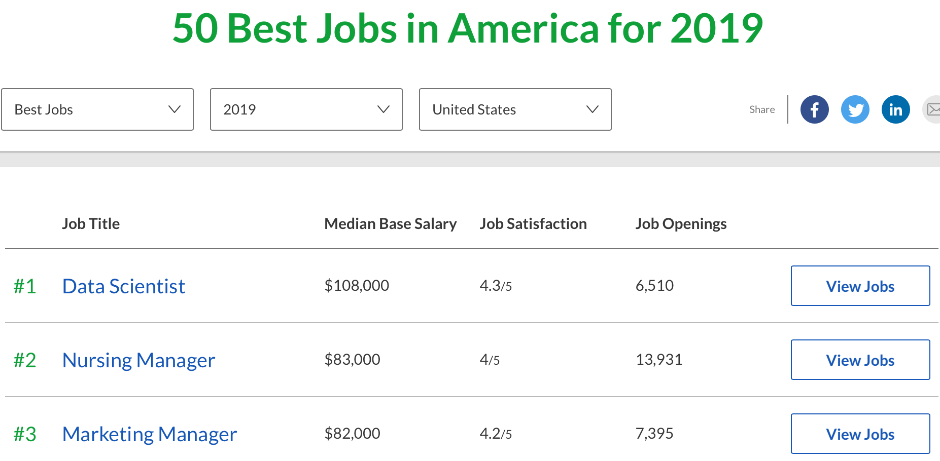

Introduction – Overview of Data Science Continued
Data Science, as it’s practiced, is a blend of Red-Bull-fueled hacking and espresso-inspired statistics!
Glassdoor ranked data scientist as the No. 1 job in their 50 Best Jobs in America in 2019 for the third consecutive year.
IBM predicts demand for data scientists will soar 28 percent by 2020 External link .
LinkedIn’s Most Promising Jobs 2018 External link report ranks data scientist in its top 10 most promising jobs and data science-related skills as some of the skills companies need most.
Offset Analytics Article Link:
Understanding the Data Scientist
Push your personal boundaries and also those of statistics with data science.

Slide 5
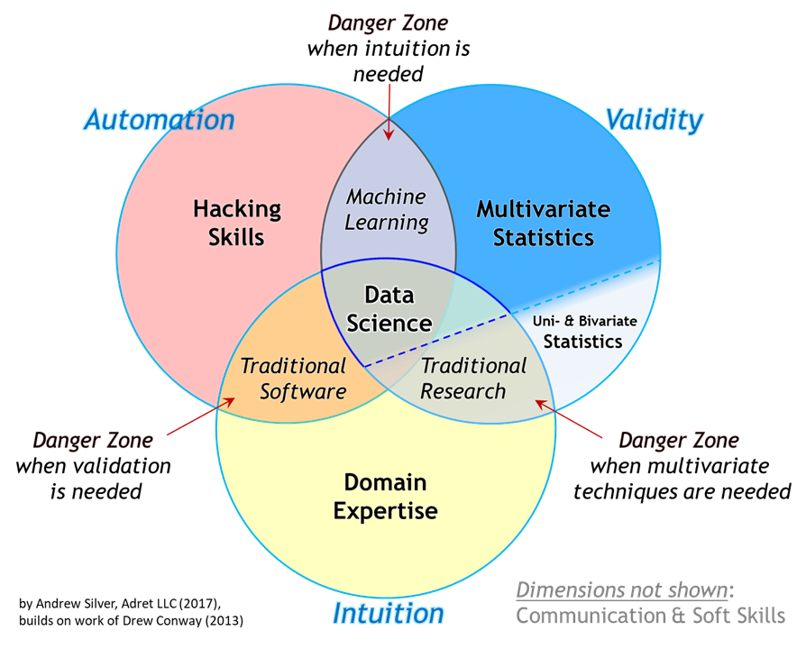

Slide 6
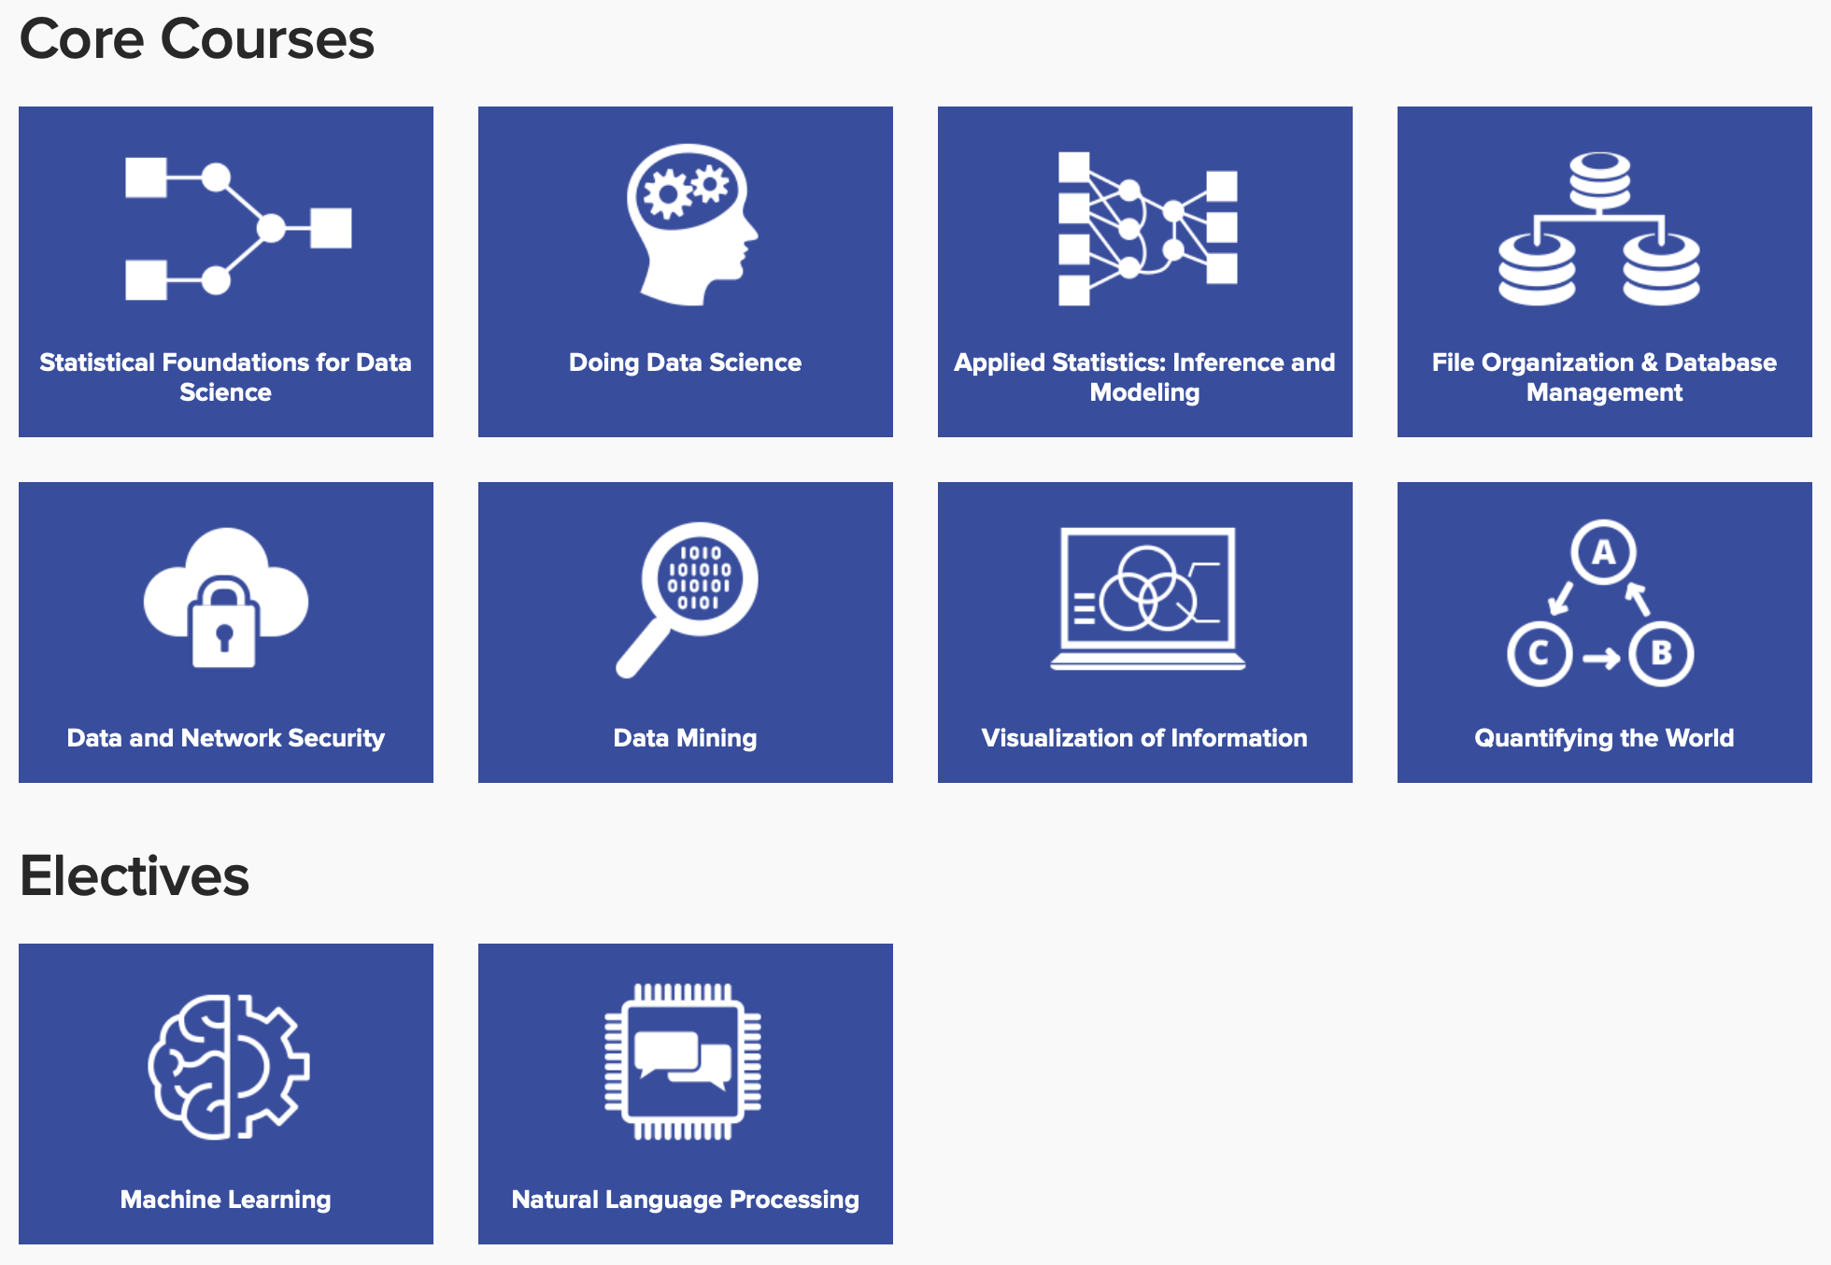
DataScience@SMU – Machine Learning Specialization
The Machine Learning Specialization is for students who wish to master the machine learning skills that are required in highly technical data science careers. Students learn to utilize advanced computational algorithms needed to build platforms that expand the boundaries of machine cognitive function to provide solutions, advance automation and evolve processes.
Students should choose a Machine Learning Specialization if they’re interested in:
Pursuing highly technical careers.
Understanding the structure of data through the use of an iterative approach.
Utilizing advanced computational algorithms to build models that expand machine cognitive functions.
Advancing automation and pattern recognition.
Applying algorithms and models to solve complex problems.
The 33.5-credit program can be completed in as little as 20 months:
24 core credits 6 elective credits 2 capstone credits
1.5 immersion experience credits

Slide 7
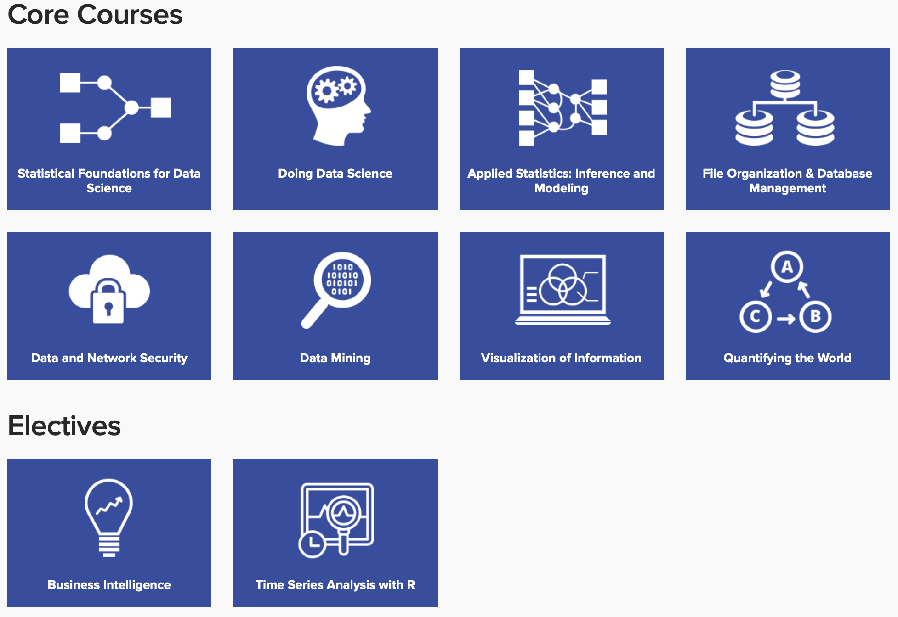
DataScience@SMU – Business Analytics Specialization
The Business Analytics Specialization is for students seeking to master the ability to utilize the information available at the end of the data life cycle and to employ advanced qualitative analysis to help businesses improve performance, operations and strategic decision-making. Students will gain skills that allow them to synthesize data, make informed conclusions, present to stakeholders with clear, impactful visualizations and lead strategic discussions among diverse audiences in their business or organization.
Students should choose a Business Analytics Specialization if they’re interested in:
Managing information and high-level business strategy.
Synthesizing results and opportunity to meet business needs.
Effectively visualizing and communicating results to diverse stakeholders.
Translating technical analysis to qualitative action items.
The 33.5-credit program can be completed in as little as 20 months:
24 core credits 6 elective credits 2 capstone credits
1.5 immersion experience credits

Slide 8
Outline of Topics Covered
Introduction
Overview of Data Science
DataScience@SMU
Overview of Machine Learning (ML)
Types of Machine Learning
Common Algorithms
Selected ML Applications in Geoscience:
Geology and Geophysics Cases:
Facies Classification
Petrophysical Data Prediction
Conclusion
Data Science Issues
Considerations
Questions
References
Hands-On Supervised Machine Learning with IODP Data!!!

Slide 9
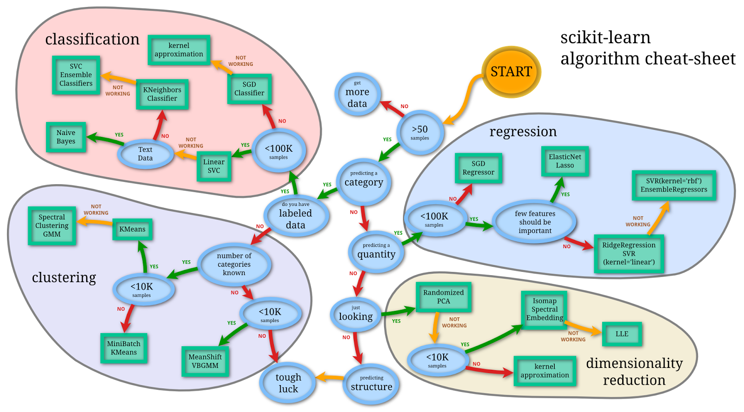
Machine Learning (ML) – What it is
ML is a system that can recognize patterns by using mathematical algorithms to “learn” insights from data without explicitly programming them to do so.
There are three main types of machine learning:
Supervised Learning
Unsupervised Learning
Reinforcement Learning
scikit-learn.org

Slide 10
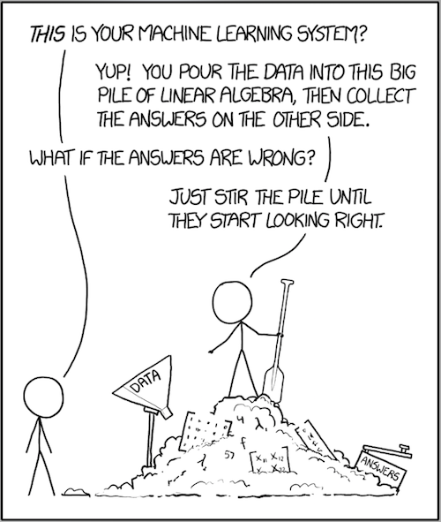
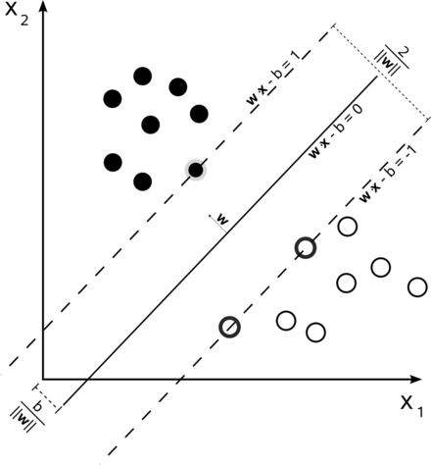
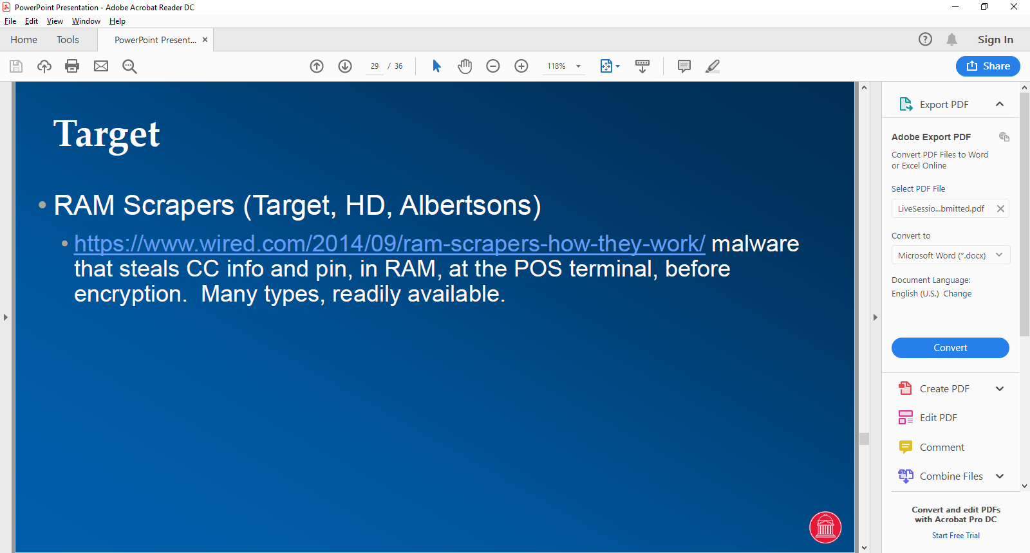
Machine Learning (ML) – What it isn’t
ML is not a magical “black box” that will find answers from unarranged data!
Support Vector Machine (SVM) – a supervised machine learning model that divides the data into linear boundaries of classified regions.
https://en.wikipedia.org/wiki/Machine_learning

Slide 11
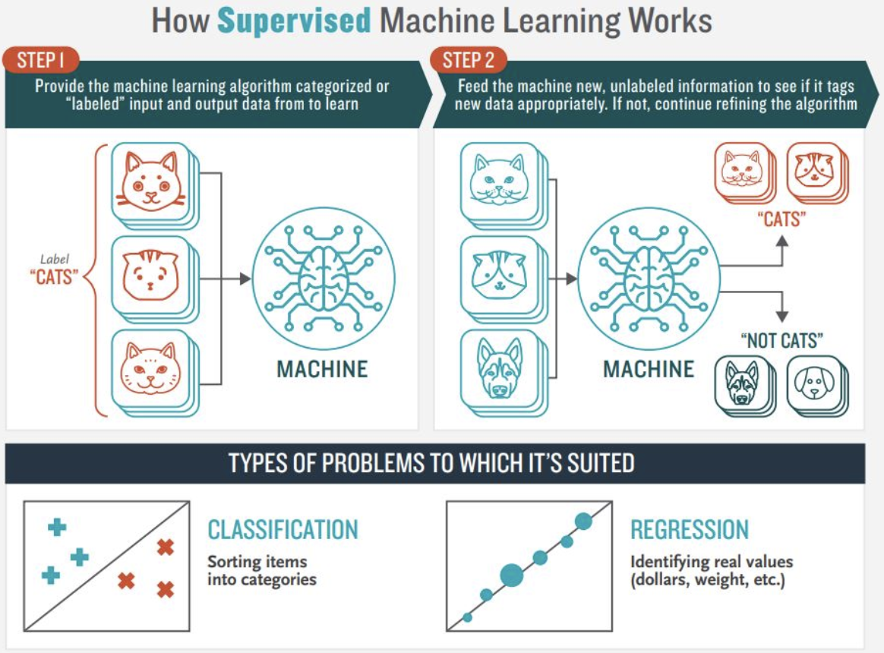
Machine Learning (ML) – Supervised Learning
The aim of supervised machine learning is to build a model that makes predictions based on evidence in the presence of uncertainty.
A supervised learning algorithm takes a known set of input data and known responses to the data (output) and trains a model to generate reasonable predictions for the response to new data.
Classification techniques predict discrete responses – for example, whether an email is genuine or spam, or whether an online news article is popular or unpopular.
Regression techniques predict continuous responses – for example, changes in temperature or fluctuations in power demand.
supervised-machine-learning

Slide 12
Supervised Learning – Algorithms
Classification:
Support Vector Classification (SVC)
Naïve Bayes
K-Neighbors Classifier
SVC Ensemble Classifiers
Stochastic Gradient Descent (SGD) Classifier
Kernel Approximation
Convolutional Neural Networks
Recurrent Neural Networks
Regression:
Stochastic Gradient Descent (SGD) Regression
Elastic Net LASSO
Ridge Regression
Support Vector Regression (SVR) kernel = ‘linear’
Support Vector Regression (SVR)
Ensemble Regressors SVR(kernel = ‘RBF’)

Slide 13
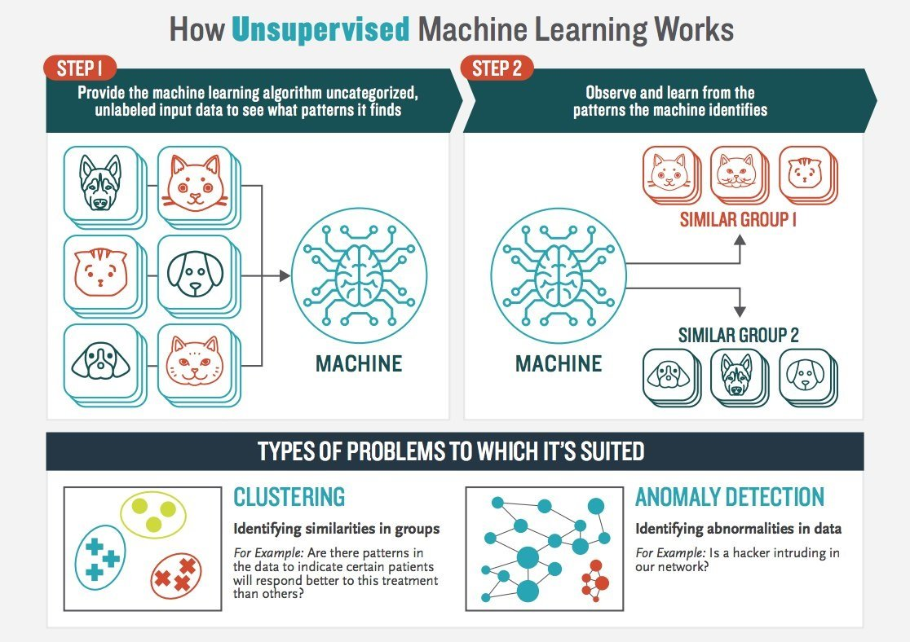
Machine Learning (ML) – Unsupervised Learning
The aim of unsupervised machine learning is to build a model that finds hidden patterns or intrinsic structures in data.
Clustering techniques uncover patterns – for example, whether there are any patterns in data to indicate groupings of features.
Anomaly Detection techniques find new patterns in network data – for example, is there a new pattern within the network data that is anomalous?
unsupervised-machine-learning

Slide 14
Unsupervised Learning – Algorithms
Clustering: Labeled Data
Mean Shift Variational Bayesian Gaussian Mixture Model (VBGMM)
Mini Batch K-Means
K-Means
Spectral Clustering Gaussian Mixture Model (GMM)
Artificial Neural Networks
Cluster Analysis on Hidden Layer activations
Dimensionality Reduction:
Principal Component Analysis (PCA)
Isomap Spectral Embedding
Locally Linear Embedding (LLE)

Slide 15
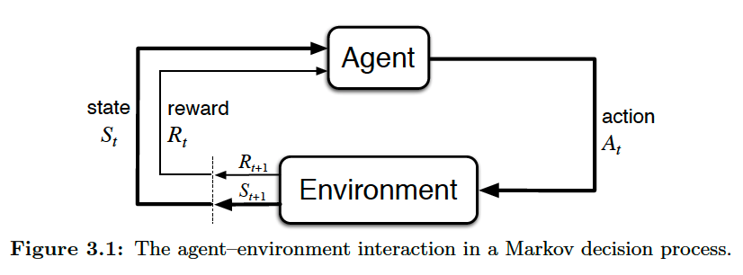
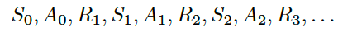

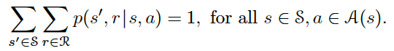
Machine Learning (ML) – Reinforcement Learning
The aim of reinforcement learning is to build a model that makes decisions based on the learned outcomes of agent-environment interactions to achieve a goal in a Markov decision process.
The learner and decision maker is called the Agent. The thing it interacts with, comprising everything outside the agent, is called the environment.
The agent-environment interact continuously, with the agent selecting actions and the environment responding to these actions presenting new situations to the agent.
The environment also gives rise to rewards, special numerical values that the agent seeks to maximize over time through its choice of actions.
The agent and Markov Decision Process together give rise to a sequence or trajectory of states, actions, and rewards (S, A, and R).
The four-argument p function is the most common conditional probability of these random variables occurring at time t, given the particular values of the preceding state and action:

Slide 16
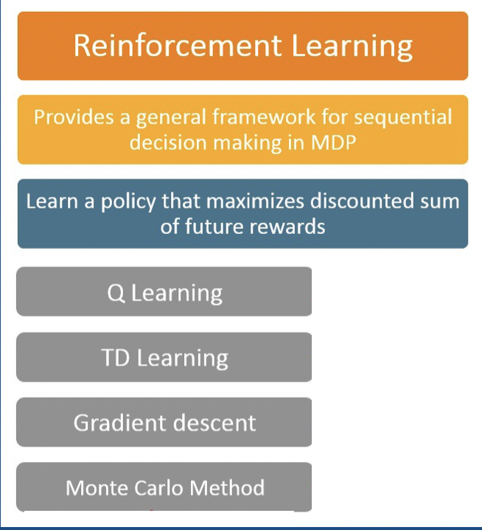
Reinforcement Learning – Algorithms
Q Learning
Q function is used to build a Q Table for different actions and rewards.
Temporal Difference Learning
Learning agent learns to predict the expected value of a variable occurring at the end of a sequence of states.
Gradient Descent
Optimization towards global minimum with
Monte Carlo Method
Monte Carlo Decision Process (MDP)
Almost all RL problems can be formalized using MDPs!

Slide 17
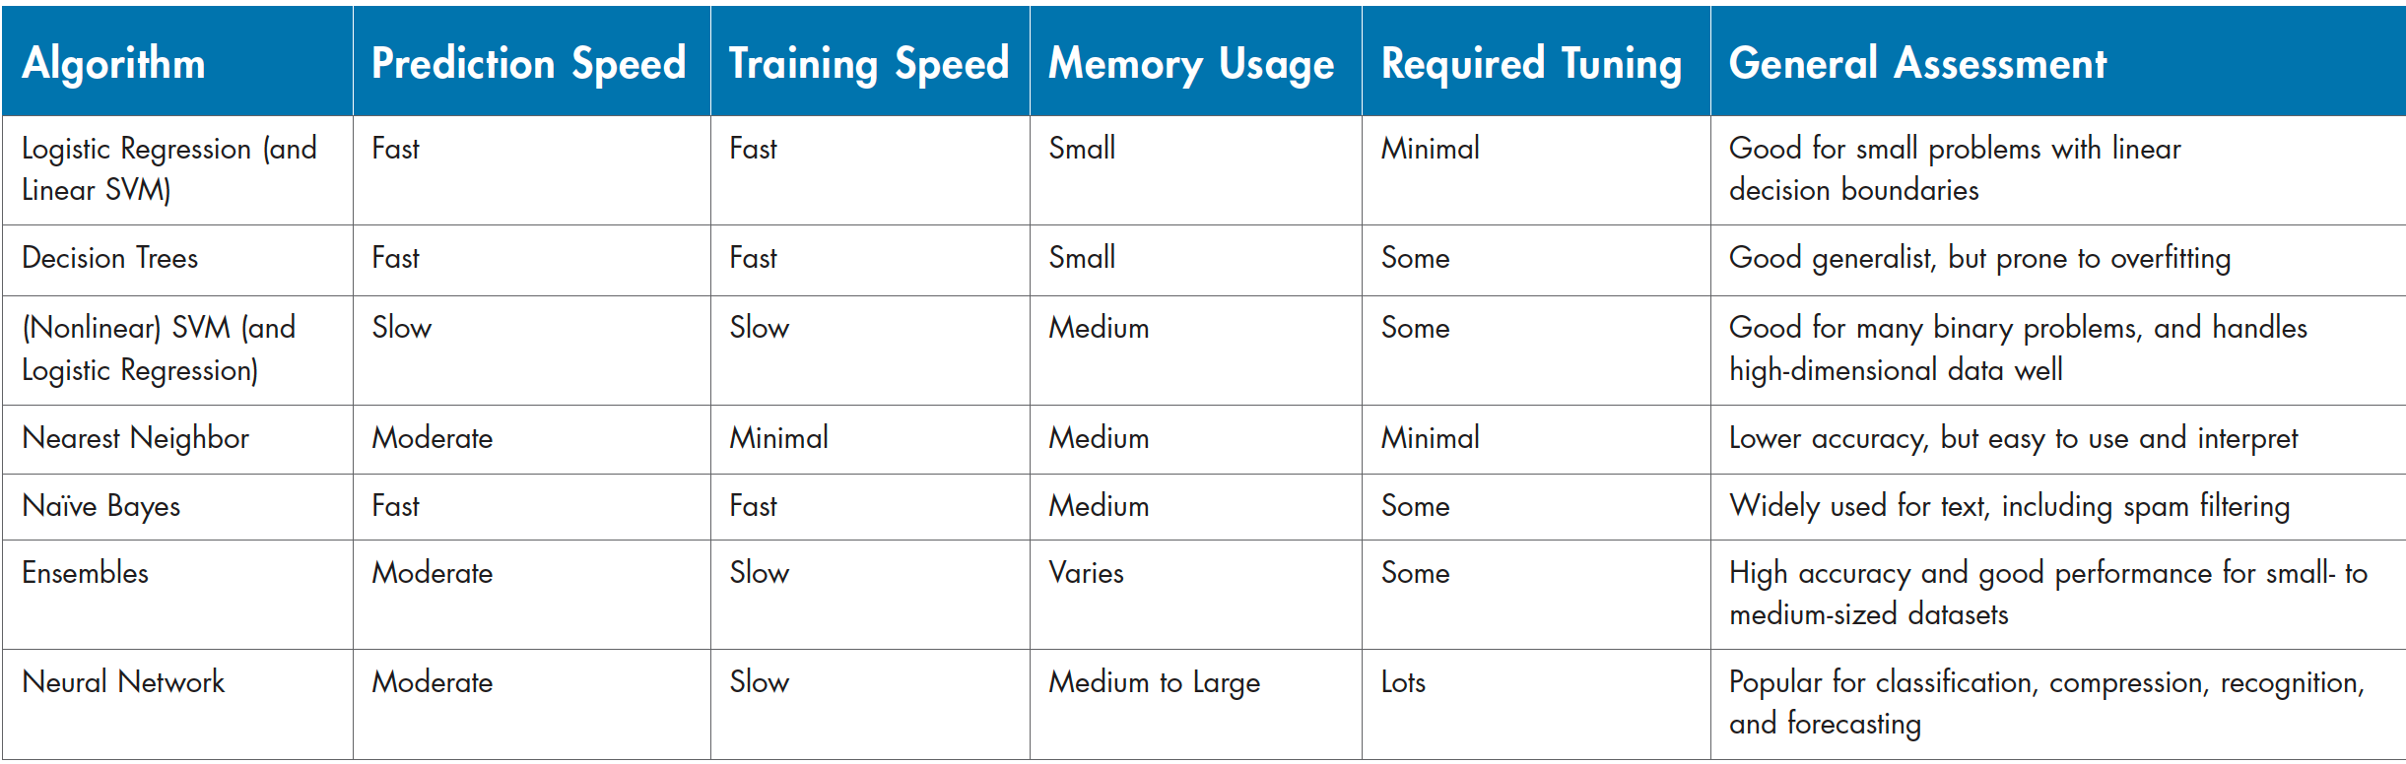
Machine Learning (ML) – Algorithm Benefits

Slide 18
Outline of Topics Covered
Introduction
Overview of Data Science
DataScience@SMU
Overview of Machine Learning (ML)
Types of Machine Learning
Common Algorithms
Selected ML Applications in Geoscience:
Geology and Geophysics Cases:
Facies Classification
Petrophysical Data Prediction
Conclusion
Data Science Issues
Considerations
Questions
References
Hands-On Supervised Machine Learning with IODP Data!!!

Slide 19
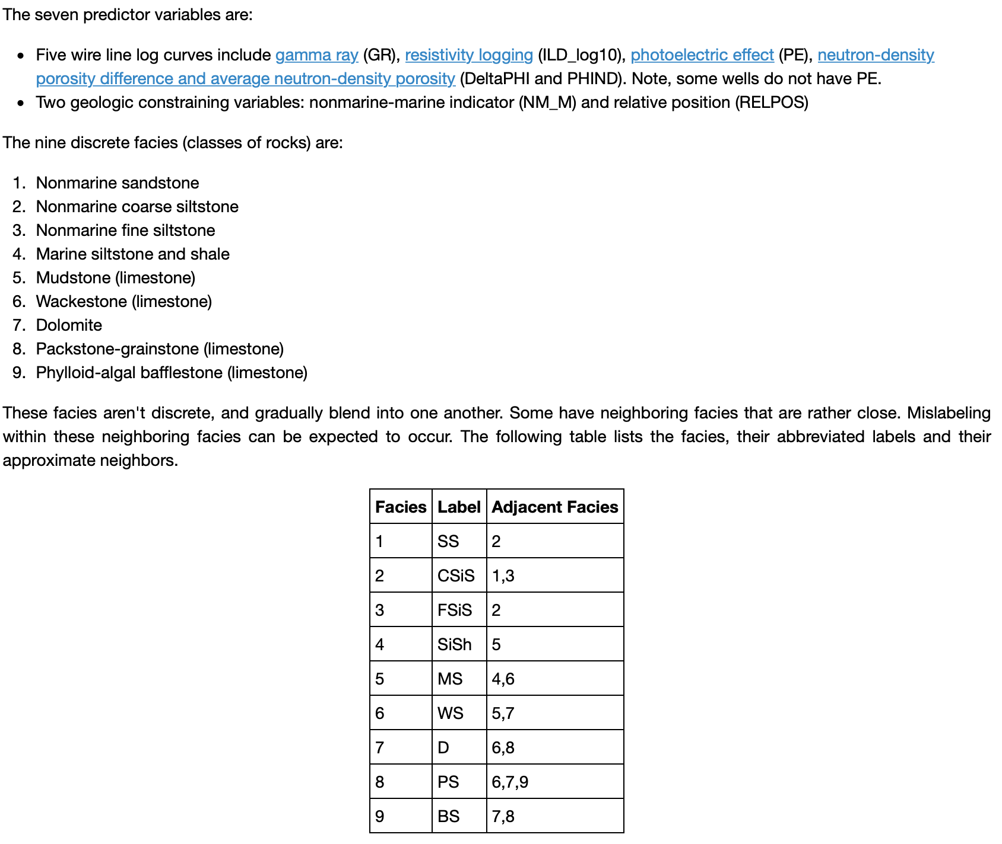
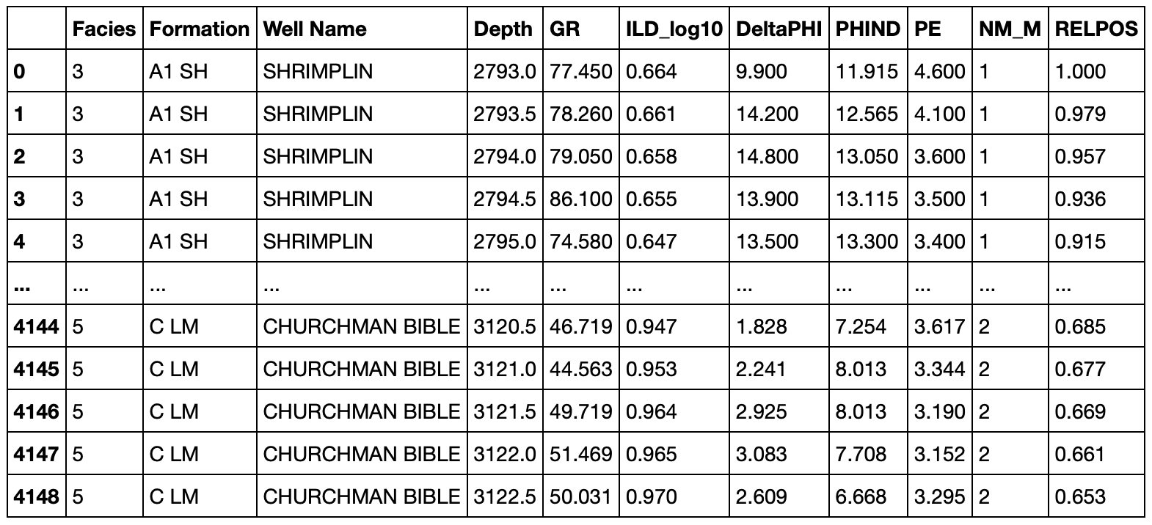
Geologic Application of Machine Learning
Facies Classification
Brendon Hall with Enthought has an awesome example of facies classification on GitHub.
https://github.com/brendonhall/facies_classification

Slide 20
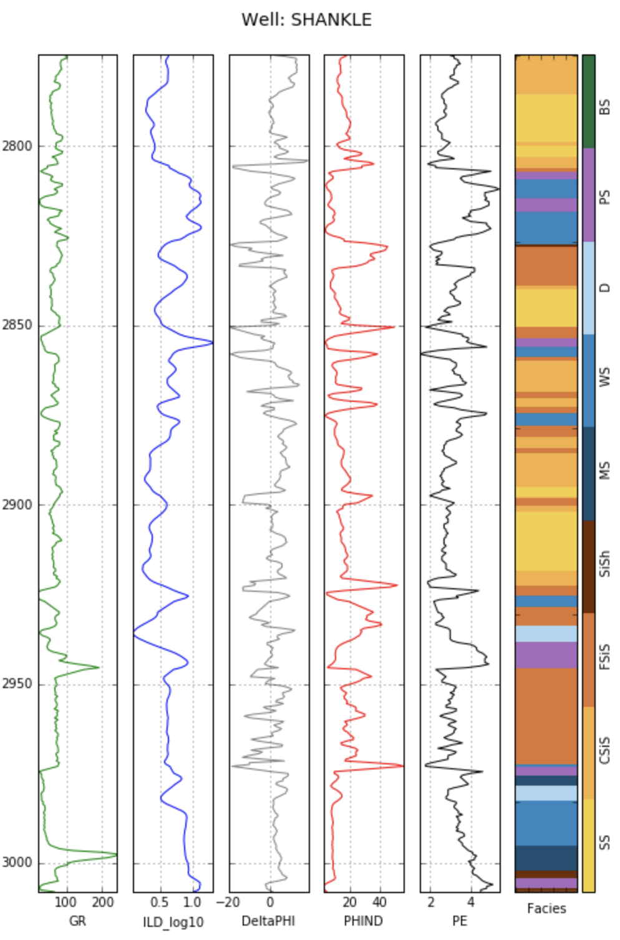
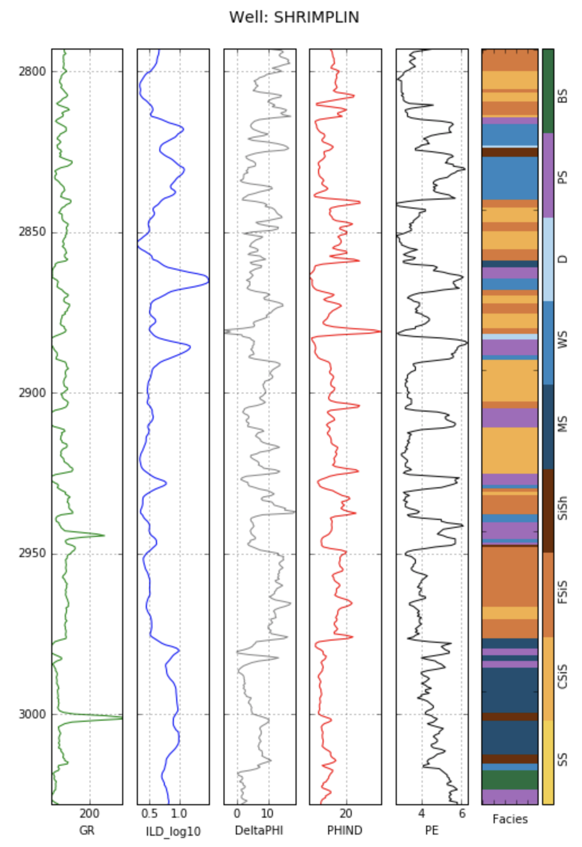
Geologic Application of Machine Learning
Facies Classification

Slide 21
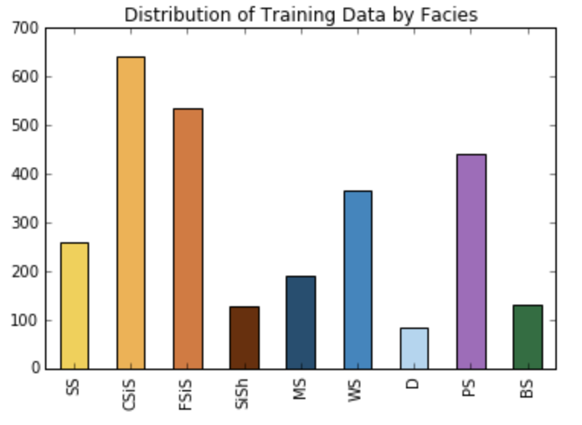
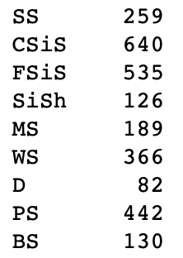
Geologic Application of Machine Learning
Facies Classification

Slide 22
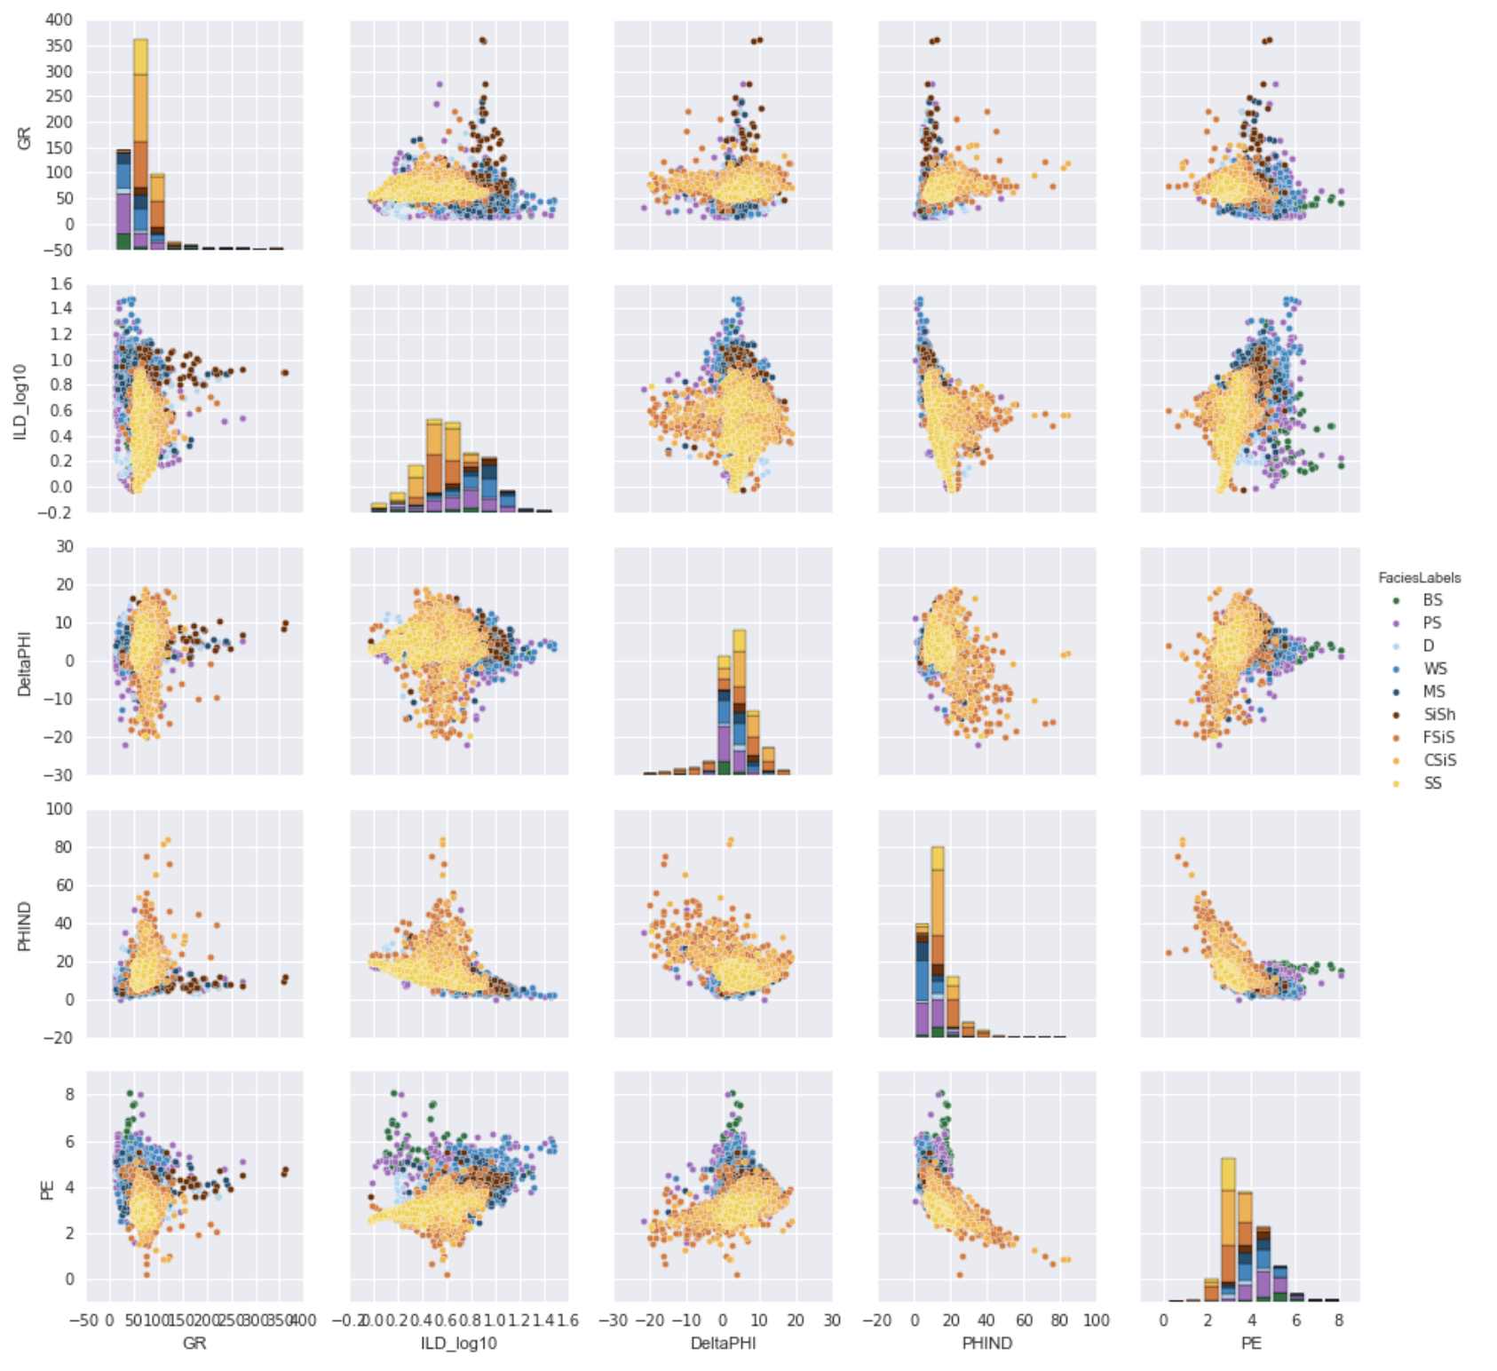
Geologic Application of Machine Learning
Facies Classification

Slide 23
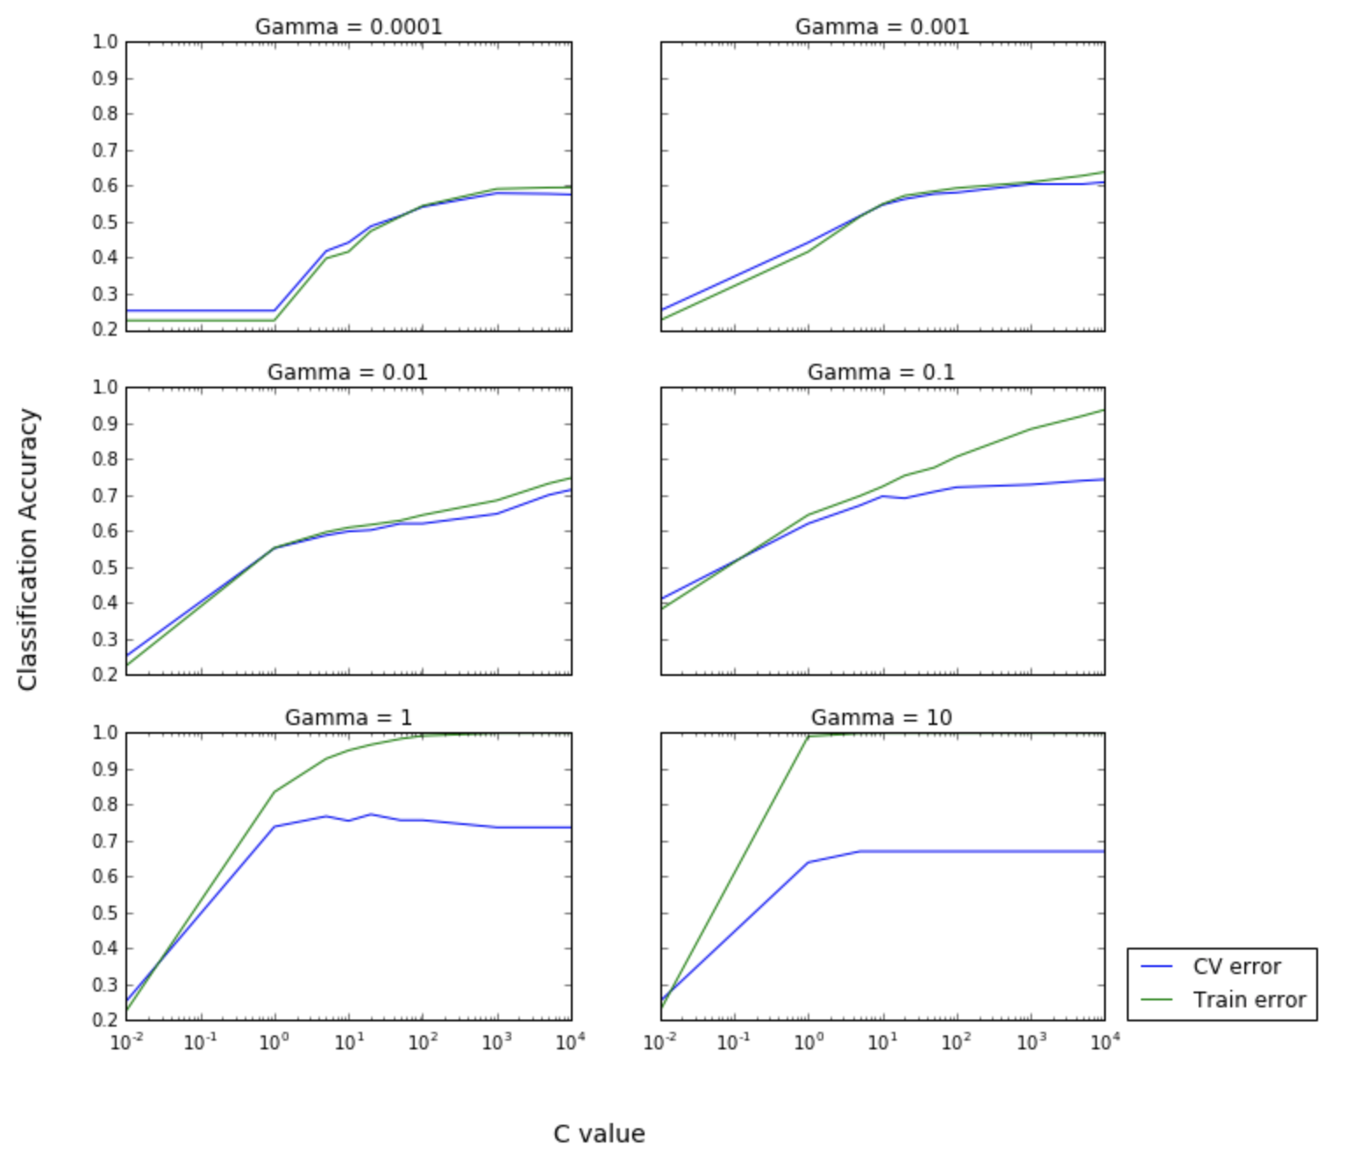
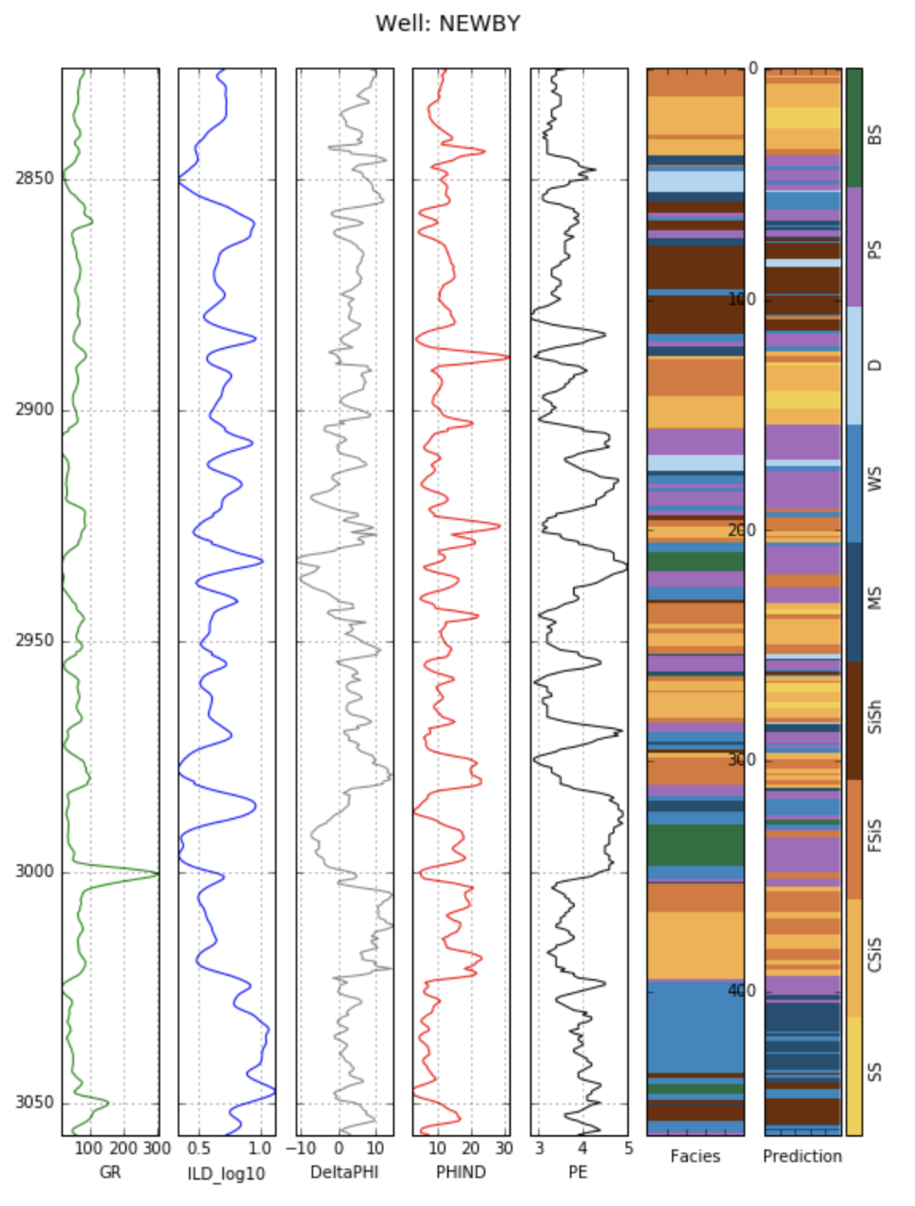
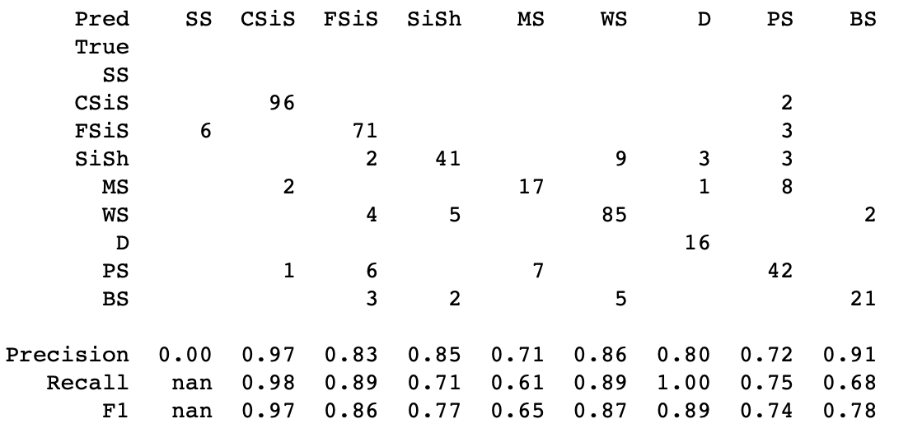
Geologic Application of Machine Learning
Facies Classification

Slide 24
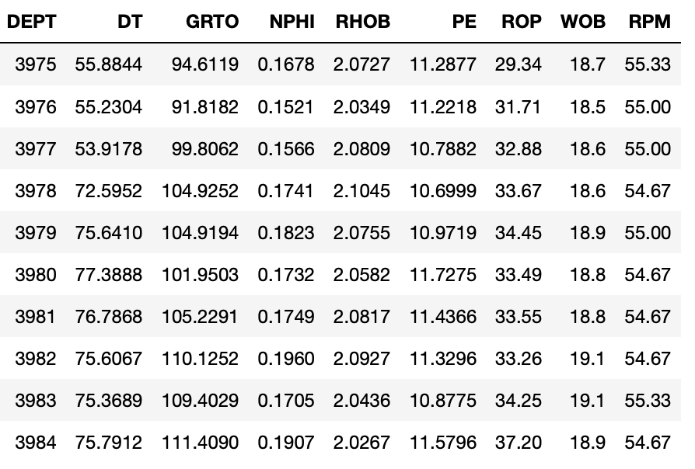
Geophysical Application of Machine Learning
Petrophysical Well Log Prediction
Let’s take a look at the work flow in the Jupyter notebook with Anaconda Navigator
ML Bootcamp Materials with data and Jupyter notebooks for Petrophysical Well Log Data ML Exercises are located in the Machine Learning Workshop.zip

Slide 25
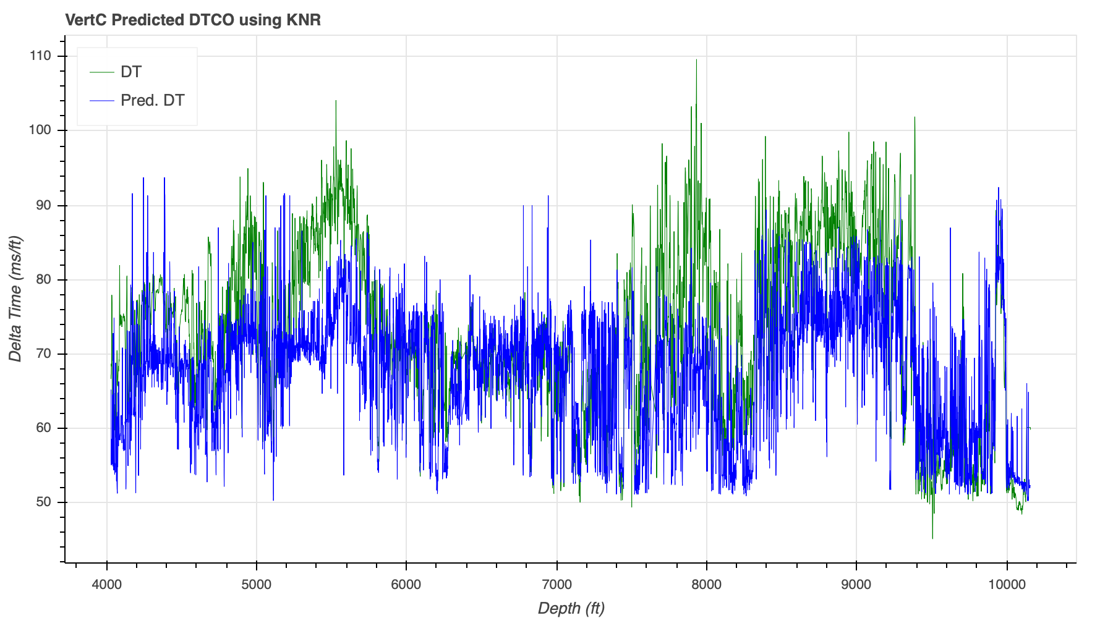
Geophysical Application of Machine Learning
Petrophysical Well Log Prediction
MAE = 7.907993305266623

Slide 26
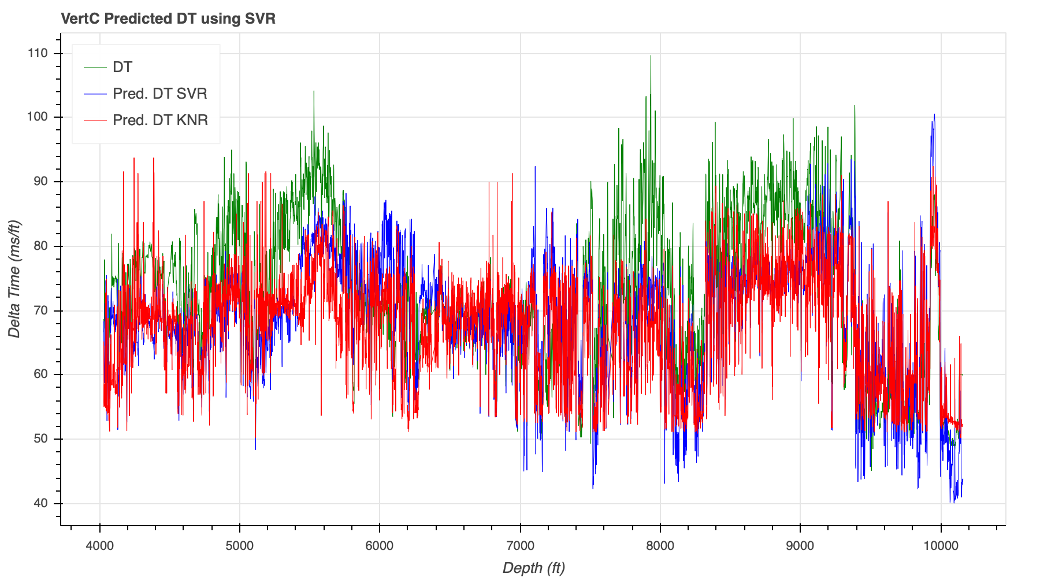
Geophysical Application of Machine Learning
Petrophysical Well Log Prediction
MAE = 7.585577074400368

Slide 27
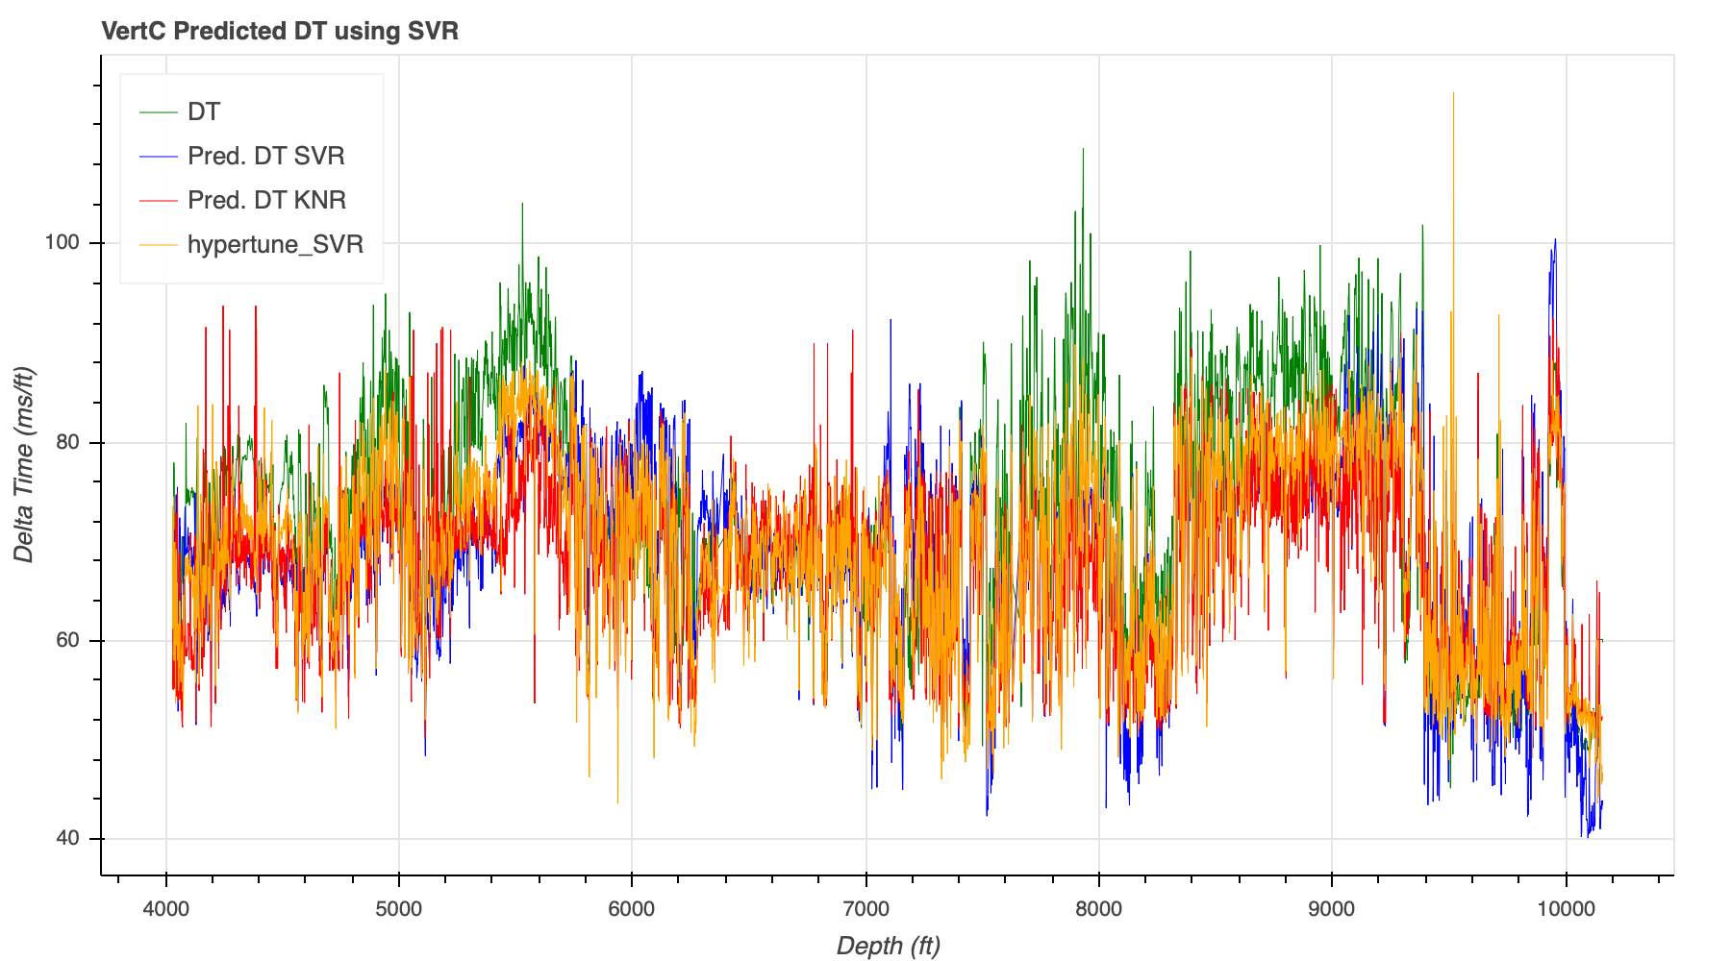
Geophysical Application of Machine Learning
Petrophysical Well Log Prediction
MAE = 5.680406251279293

Slide 28
Outline of Topics Covered
Introduction
Overview of Data Science
DataScience@SMU
Overview of Machine Learning (ML)
Types of Machine Learning
Common Algorithms
Selected ML Applications in Geoscience:
Geology and Geophysics Cases:
Facies Classification
Petrophysical Data Prediction
Conclusion
Data Science Issues
Considerations
Questions
References
Hands-On Supervised Machine Learning with IODP Data!!!

Slide 29
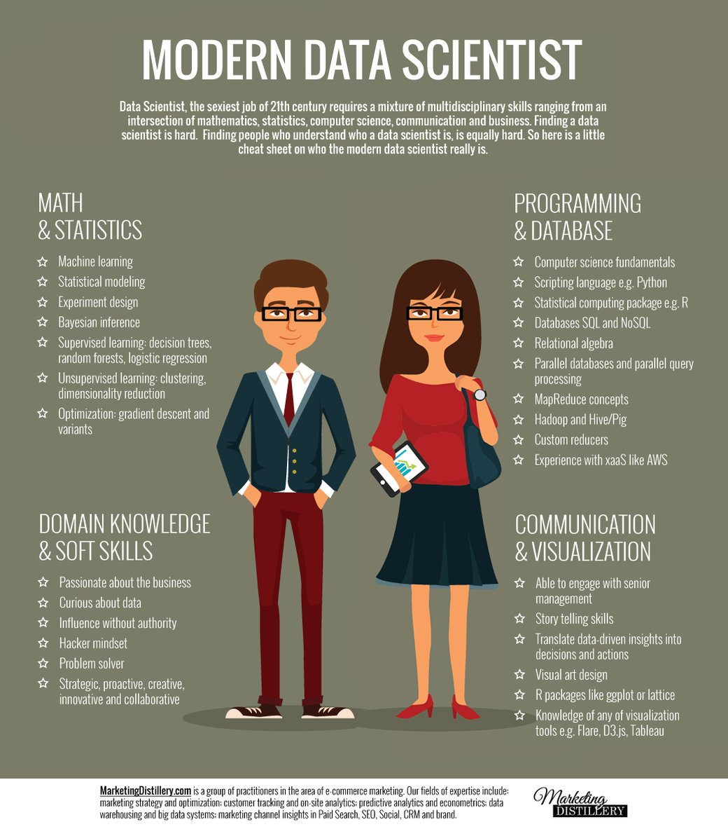
Conclusions
Issues:
Lack of Data Scientists
Machine Learning Hype
Model Validity
Lack of Data Science Leadership in many jobs
Considerations:
Learn Programming
Apply Math and Statistics
Expand Domain Expertise
Get out of your comfort zone

Slide 30

Questions

Slide 31
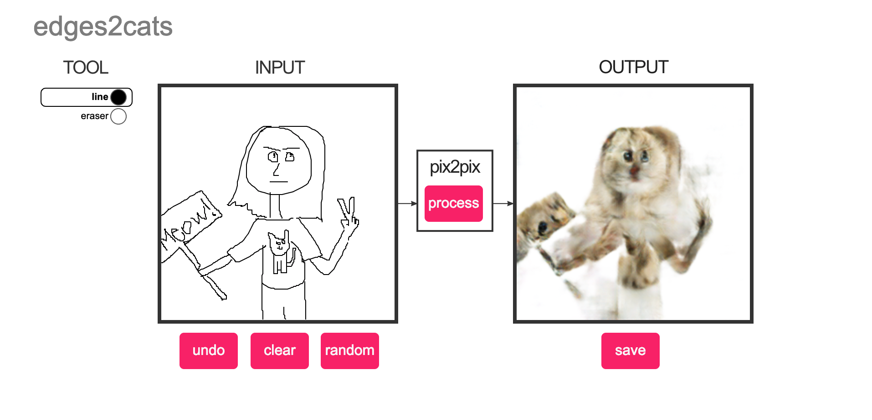
Awesome and Fun ML
https://affinelayer.com/pixsrv/index.html

Slide 32
References
Sutton, R. and Barto, A. (2018). Reinforcement learning. 2nd ed. Cambridge, MA: The MIT Press.
http://ufldl.stanford.edu/tutorial/supervised/ConvolutionalNeuralNetwork/
https://towardsdatascience.com/machine-learning-101-an-intuitive-introduction-to-gradient-descent-366b77b52645
https://web.stanford.edu/group/pdplab/pdphandbook/handbookch10.html
https://medium.freecodecamp.org/an-introduction-to-q-learning-reinforcement-learning-14ac0b4493cc
https://people.eecs.berkeley.edu/~jordan/courses/294-fall09/lectures/clustering/slides.pdf
https://cs.nyu.edu/~roweis/lle/algorithm.html
https://towardsdatascience.com/from-classic-ai-techniques-to-deep-learning-753d20cf8578
https://machinelearningmastery.com/a-tour-of-machine-learning-algorithms/
https://s3.ap-south-1.amazonaws.com/techleer/207.jpg
https://www.kdnuggets.com/2018/03/5-things-reinforcement-learning.html
https://kittipatkampa.wordpress.com/2010/10/14/variational-bayesian-gaussian-mixture-model-vbgmm/
https://cs.nyu.edu/~roweis/lle/algorithm.html
http://www.jmlr.org/papers/volume3/guyon03a/guyon03a.pdf

